Slide 1

BLOCKCHAIN-BASED CARBON CREDIT ECOSYSTEM
Guided by : Mrs. Parvati Bhadre

Slide 2
TEAM MEMBERS
Roll No. | Exam Seat No. | Name
BE22IT071 | B400080856 | Amol Netke
BE22IT072 | B400080916 | Yogesh Zade
BE22IT074 | B400080816 | Harsh Satwani
BE22IT076 | B400080900 | Yuvrajsing Solanke

Slide 3
CONTENTS
Introduction
Problem Statement
Solution
System Design
Limitations
Future Scope
Conclusion

Slide 4
INTRODUCTION
What is a Carbon Credit ?
A carbon credit is a certificate that represents the reduction of one metric ton of carbon dioxide (CO₂) or an equivalent amount of other greenhouse gases (GHGs) from the atmosphere.
It serves as proof that emission reductions have occurred, often generated through carbon sequestration projects like reforestation, renewable energy, sustainable farming.
Carbon Tokens are the digital representation of carbon credits, stored and traded on a blockchain platform.

Slide 5
INTRODUCTION
Need of Carbon Credits
Allow companies to balance their emissions by supporting green projects elsewhere.
Encourage investments in renewable energy, forestation, and sustainable farming.
Create a market system that motivates businesses to act responsibly towards the environment.

Slide 6
PROBLEM STATEMENT
To develop a decentralized carbon credit platform that ensures transparent, secure, and efficient tracking and trading of carbon credits, reducing fraud and costs while promoting trust and sustainability through automated processes.
Current issues
The carbon credit market is fragmented, with multiple platforms, registries, and processes, which can create inefficiency and lack of transparency.
The trustworthiness of credits can be challenged without a transparent system to verify that emissions reductions actually occurred.
Many smaller organizations or individual farmers struggle to participate in the market due to high transaction costs, complexity, and lack of access to buyers.
Ensuring the accurate monitoring and tracking of carbon offset projects is a significant hurdle.

Slide 7
SOLUTION
Our prototype is a web application built on the Ethereum blockchain, featuring key stakeholders and their interactions as described below :
Stakeholders :
Generators : Entities running eco-friendly projects that generate carbon credits.
Consumers : Entities emitting carbon and purchasing credits to offset their emissions.
Validators : Accredited authorities verifying evidence from generators and consumers, managing credit issuance and retirement requests.

Slide 8
SOLUTION
Initially, entities register and log in to their dashboards, connecting their MetaMask wallets.
Workflow – Generator & Validator :
Generators upload evidence of carbon reduction using satellite images showing their project area.
The system calculates the NDVI (Normalized Difference Vegetation Index) for the selected region to measure vegetation health (value between -1 to 1).
NDVI data and coordinates are sent in real-time to validators’ dashboard.
Validators check the NDVI and we use a prototype formula to estimate how much CO₂ is absorbed : CO₂ = NDVI × 10 (minimum 1 ton)
If both validators approve, carbon credit tokens (CCT) equal to the estimated CO₂ are minted and credited to the generator’s wallet.
Example: 1 ton of CO₂ reduced = 1 carbon credit token.

Slide 9
SOLUTION
Workflow – Generator & Consumer :
Generators list their carbon credit tokens (CCT) on an Automated Market Maker (AMM) marketplace.
Consumers (carbon emitters) browse the marketplace and find sellers offering CCTs.
Consumers select a seller and trade ETH to buy the carbon credits (CCT).
This allows consumers to offset their carbon emissions by purchasing CCTs from generators.
When a trade happens, the generator’s CCT balance goes down, the consumer’s CCT balance goes up, and the generator receives ETH in their wallet

Slide 10
SOLUTION
Workflow – Consumer & Validator :
Consumers burn their carbon credit tokens (CCT) to retire their emissions.
The token burn request (with amount and consumer details) is sent to validators via socket.
Multiple validators review and approve the retirement request. Once approved, a custom contract issues a Carbon Removal Certificate (NFT) to the consumer’s address.
The certificate records the retired amount and the timestamp as proof of carbon offset.
In this prototype, we use 1-to-1 user interaction with simulated validators. In real deployment, validators can be authoritative entities like NGOs or government bodies. Project data and calculations are dummy and can be replaced with real standards at scale.

Slide 11
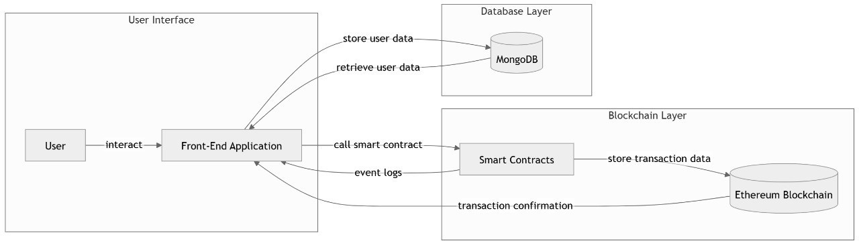
SYSTEM DESIGN
3-tier system architecture

Slide 12
SYSTEM DESIGN
The proposed blockchain-based carbon credit ecosystem is implemented using a three-tier architecture, which separates the system into the following layers :
Presentation Layer (Frontend) :
This layer consists of a React.js based web application that serves as the user interface.
Users such as carbon credit generators, validators, government authorities, and buyers interact with the system through this interface.
It handles user inputs, displays data, and communicates with the blockchain network and backend service

Slide 13
SYSTEM DESIGN
Business Logic Layer (Blockchain Layer) :
The core functionality of our prototype is built on four smart contracts deployed on a local Ethereum blockchain (Ganache). These contracts automate transactions, enforce rules, and maintain an immutable record of carbon credit activities :
MintCCT Contract : Mints Carbon Credit Tokens (CCT) for validated carbon reduction projects.
MintNFT Contract : Issues Carbon Removal Certificates (CRC) upon retirement of CCT by consumers.
AMM Contract : Enables decentralized trading of CCTs using an Automated Market Maker model.
MultiValidator Contract : Manages multi-signature approval to validate and authorize carbon projects.

Slide 14
SYSTEM DESIGN
Data Layer (Off-chain Database) :
MongoDB is used to store all off-chain data.
This 3-tier architecture enables a modular, scalable, and secure carbon credit ecosystem where the frontend offers usability, the blockchain layer guarantees transparency and trust, and the off- chain database ensures efficient data management.

Slide 15

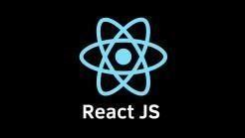



TECH STACK
React.js : Builds the frontend UI, enabling users to submit data, track tokens, and interact in real-time.
Solidity : Powers smart contracts for minting, validating, trading (AMM), and retiring carbon credits.
Truffle & Ganache CLI : For compiling, testing, and deploying contracts on a local Ethereum test network.
MetaMask : User wallet for signing blockchain transactions and connecting to the test network.

Slide 16
LIMITATIONS
Regulatory uncertainty may affect adoption across different countries.
Legal status of carbon credits on blockchain is unclear in many jurisdictions.
Complex for non-technical users due to wallet setup and transaction handling.
User education and better UI/UX are needed for wider adoption.
Integration with existing carbon credit systems can be challenging.
Ensuring data privacy while maintaining transparency is difficult.
User education and better UI/UX are needed for wider adoption.

Slide 17
FUTURE SCOPE
Integrate Layer-2 scaling solutions to reduce transaction costs and improve speed.
Enable cross-chain compatibility with major blockchains for wider access.
Use AI and machine learning to automatically verify carbon credits and detect fraud, incorporating real-time satellite and sensor data.
Evolve into a DAO allowing stakeholders to vote on platform upgrades and enforce compliance through smart contracts.
Develop user-friendly mobile apps with gamification and partner with businesses to enable easy carbon offsetting during purchases.
Introduce marketplaces for carbon credit NFTs tied to projects and crowdfunding options for early-stage green initiatives.

Slide 18
CONCLUSION
The prototype blockchain-based carbon credit ecosystem successfully demonstrates how decentralized technologies can streamline carbon credit issuance, trading, and retirement.
By integrating satellite-based NDVI data for project validation, automated multi-validator approvals, and tokenized carbon credits on Ethereum, the platform ensures transparency, security, and user control.
The use of smart contracts for minting, trading via AMM, and NFT-based retirement certificates highlights the potential for automation and fraud reduction.
Although currently a simplified model with simulated data and validators, this solution lays a strong foundation for future scaling with real-world entities, improved verification, and enhanced user accessibility—paving the way for a more trustworthy and efficient global carbon market.

Slide 19
THANK YOU !!!

